Slide 1


CS 5800 Final Project Self Driving Car Navigation System
Rohit Hooda, Sindhu Krovvidi, Tanvi Magdum
CS 5800 Project

Slide 2
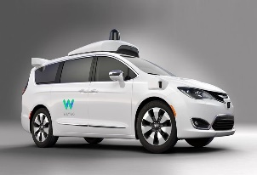
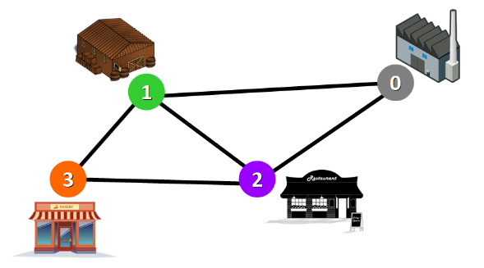
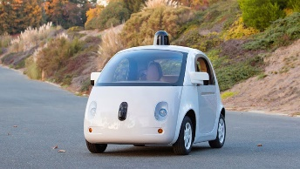
Self Driving Car Navigation System
How does Self Driving Car finds the optimal route?
Project Goals
The Self Driving Car Navigation System project helps one to answer the following question: How does a self driving car travels from starting point A to destination B using the shortest route possible?
This project aims to solve the question of how to reach from point A to B via the shortest possible route, while also minimizing the time taken for the journey.
Unlike traditional shortest path problems, this project takes into account various parameters like traffic, weather conditions that a self-driving car needs to consider when selecting the optimal route and calculating the minimum distance.
Use techniques learned in the course, including dynamic programming, greedy approaches, graphs, and shortest path algorithms to devise the self driving car’s navigation system
Compare different path finding algorithms and leverage a shortest path algorithm i.e., A* in order to reach the destination covering the fewest miles in the least amount of time possible

Slide 3
Basic Approach & Assumptions
We created a graph class (V,E) where the vertices represents locations; the edges represent routes between them. The weights of the edges represent the distance and the heuristic cost in miles between the source and the destination
In our algorithms, we are provided with several input parameters, including:
Number of vertices in the graph
Start and Destination vertex
Edges between vertices with weights and heuristic cost
Shortest path and live traffic conditions

Slide 4
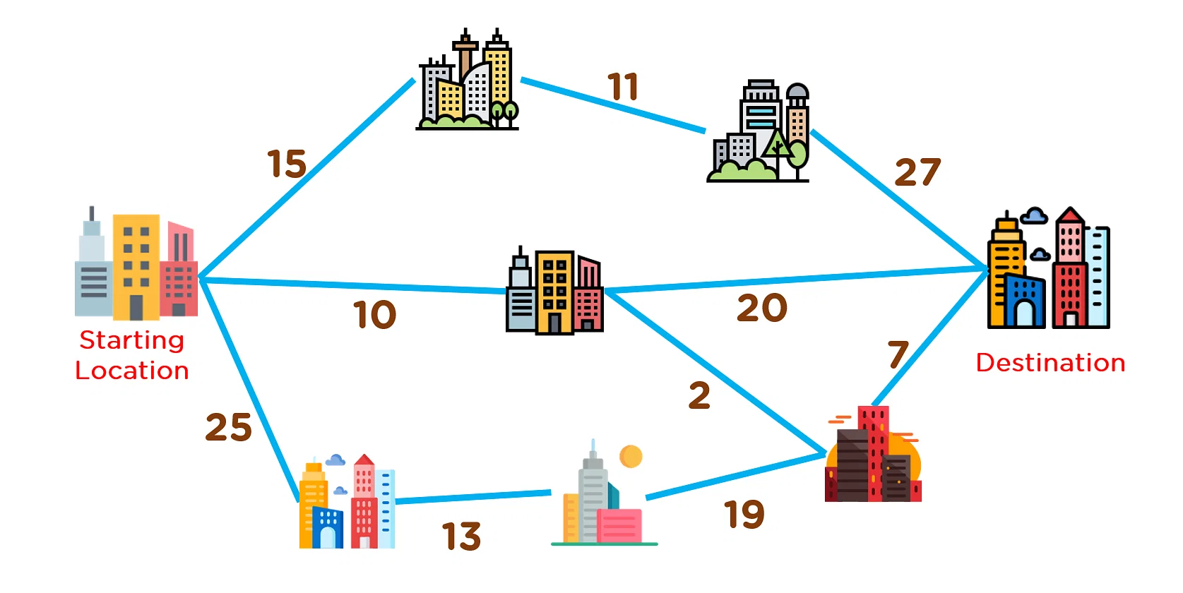
Real-World Use Case
As an example case, we have examined a graphical representation of a city, wherein a self-driving car is utilized to travel from point A to point B.
This specific graph comprises 8 vertices, with the Starting Location serving as the origin, and the Destination point as the endpoint.
The edges of the graph correspond to the distances between each node, and the presence of traffic between each vertex is a factor that affects the cost calculation of traveling from the current vertex to the destination.

Slide 5
Implementation Details
Methods
A* Pathfinding Methods
Graph class to represent the map and edges, with methods such as:
setTraffic
getTraffic
getHeuristic
getNeighbours
getWeight
Primary A*_selfDrivingCar method which leverages the Graph class:
Given a graph, start and destination nodes, and initial input parameters like traffic, distance between vertices
Iterate through the graph, keeping track of visited nodes and current location and heuristic cost to reach the destination after reaching each node
Leverage A* Algorithm to consider the closest unvisited node while taking distances from the current node in account
Returns the nodes visited in the path from the start to the destination
We developed the following pathfinding methods :
shortestPath method which looks ahead at upcoming potential nodes to scan and assess whether we can reach to the destination faster considering the heuristic cost and traffic cost
getPath method which uses A* algorithm to find the shortest route recomputes the whole route if the distance/ time to reach the destination increases and checks again whether can we reach to the destination or not

Slide 6
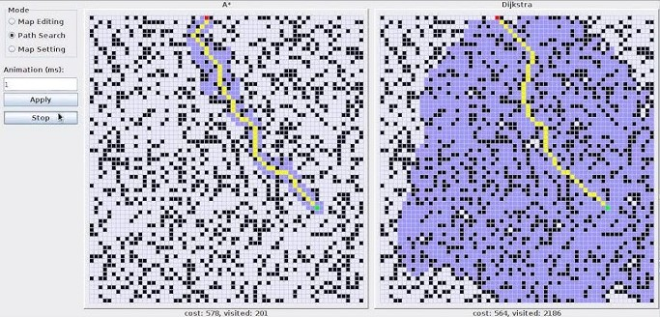
Comparison of A* with other algorithms
A*: Cost 578
Visited Nodes 201
Dijkstra: Cost: 564
Visited Nodes: 2186

Slide 7
Results & Conclusion
The algorithm performs as expected, finding shortest paths while accounting for different conditions like traffic, time and distance between cities
The algorithm also performs correctly in terms of looking ahead at future nodes/future traffic conditions and redirecting the car if the current path becomes more costly and is no longer the shortest route possible
The example in the above slide illustrates how the optimal routes change depending on the input parameters and also how A* is better algorithm for finding the shortest path and why it can be used for finding the shortest path possible.Overall we are satisfied with the algorithm implementation we developed, and feel comfortable that it can be utilized to navigate a self driving car in the real world, although perhaps after testing it on a smaller scale first

Slide 8
Future Scope
Adjust algorithm to find the shortest, most cost-effective route by giving it more parameters like construction work going on or not, weather conditions, efficiency etc
Integrate the real time API like google maps API, HERE API to get the live traffic, weather conditions

Slide 9
References
https://www.youtube.com/watch?v=g024lzsknDo
https://www.youtube.com/watch?v=ySN5Wnu88nE
https://ieeexplore.ieee.org/document/9971587
https://habrador.itch.io/hybrid-a-star

